Slide 1
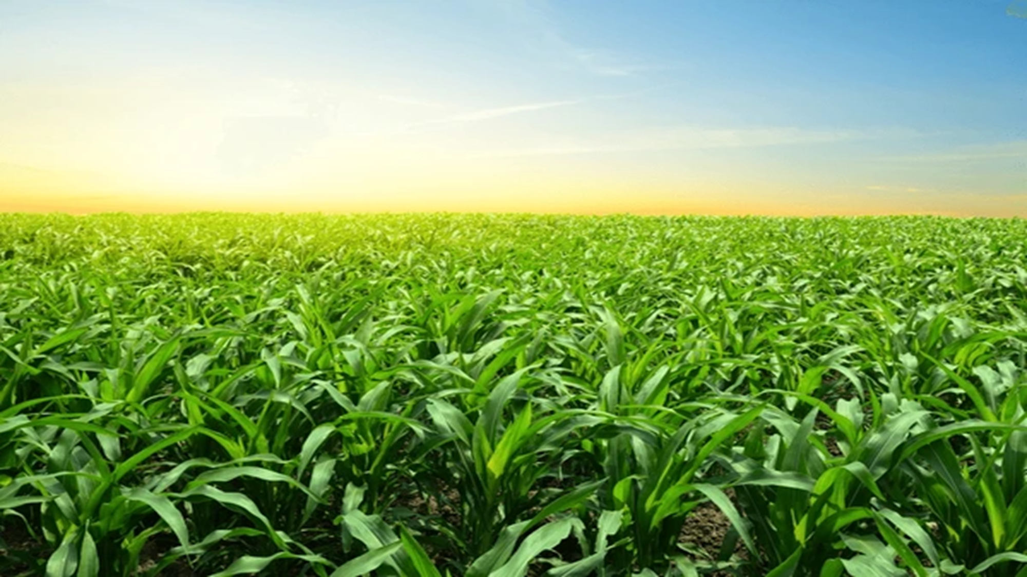
CROP PREDICTION USING MACHINE LEARNING
SUBMITTED BY:
Sukhpreet Singh
Roll number- 12201205

Slide 2
INTRODUCTION
Agriculture is a vital occupation in India, essential for the country's development, with over 60% of the land used to meet the needs of 1.3 billion people. Adopting new agricultural technologies is crucial for farmer profitability. Traditionally, crop and yield predictions were based on farmers' experience and trends, often neglecting soil nutrient content, leading to reduced yields and soil pollution. Farmers tend to choose crops based on prior trends or those grown in neighboring regions, often lacking knowledge about essential soil nutrients like nitrogen, phosphorus, and potassium. To address these issues, we designed a machine learning system to enhance agricultural practices. Machine learning, a part of artificial intelligence, leverages big data and high-performance computing to improve data-intensive agricultural processes, leading to better outcomes for farmers.
scope of the project: The scope of the project involves collecting and preprocessing diverse sets of data, including satellite imagery, weather patterns, soil quality, historical crop yields, and other relevant information. By analyzing these datasets and using machine learning techniques, the project seeks to create models that can make reliable predictions about the future performance of crops in a particular region

Slide 3
Benefits of accurate crop prediction include:
● Improved Resource Management: Farmers can optimize the use of resources such as water, fertilizers, and pesticides based on recommended crops, leading to cost savings and reduced environmental impact.
● Mitigating Food Shortages: Governments and organizations can use crop prediction to identify regions at risk of food shortages and take proactive measures to address potential food security challenges.
● Risk Management for Farmers: Knowing the best crops to plant in advance helps farmers manage financial risks and plan for market fluctuations.
● Sustainable Agriculture: By recommending crops that are well-suited to the soil’s nutrient content, agricultural practices can be more sustainable, minimizing waste and environmental damage.

Slide 4
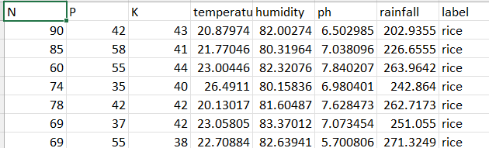
Dataset
The dataset used in this project contains various features related to soil and environmental conditions:
>N :Nitrogen value present in a soil.
>P: Phosphorus content in the soil.
>k: : Potassium content in the soil.
>temperature: this is the temperature of the soil in Celsius.
>humidity: this is the humidity of the soil in relative humidity.
>ph: this is the ph value of the soil when this value is less than the 7 than it shows the acidic nature
When it is more than the 7 than it shows the basic nature of the soil when it is 7 than it shows the neutral nature of the soil.
>rainfall: this is the input of rainfall , this input is in form of number that shows rain condition at that particular place.
>label: this icolumn shows the crop after calculating the inputs value.

Slide 5
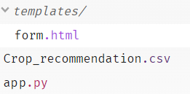
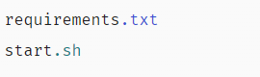
About the project
Here , Project on a glitch.com website
In this website , Create some file for operations
Templates: The templates folder contains the html file
form.html
This file help to make a frontend look of project
>Crop_recommendation.csv: This file contains the overall data of project in the form of rows and columns.
>Requirements.txt: This file contains the requirements of project that can fulfill all project needs.
>app.py: This file contains the flask coding of project. Here in this file all backend code of project is present.

Slide 6
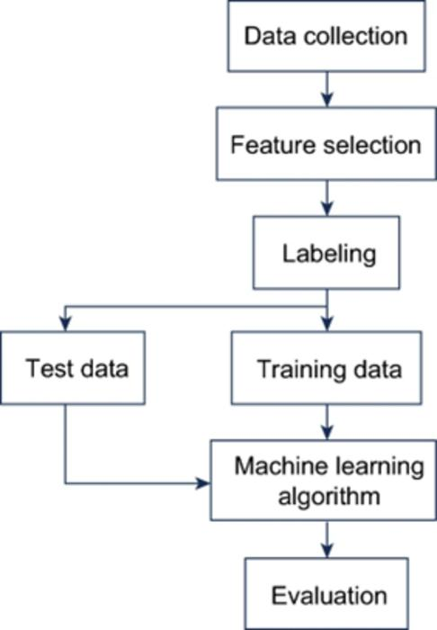
Training Flowchart

Slide 7
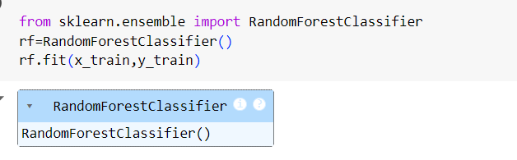
Algorithm Used:
Machine learning algorithms and statistical models are often employed to analyze these datasets and extract patterns and relationships that can be used to make predictions. For this crop prediction project, we utilized the Random Forest classifier algorithm.
Random Forest algorithm is a powerful tree learning technique in machine learning. It works by creating a number of decision tree during the training phase. Each tree is constructed using a random subset of the data set to measure a random subset of features in each partition. This randomness introduces variability among individual trees, reducing the risk of overfitting and improving overall prediction performance.

Slide 8
Results and Prediction
The machine learning model was trained on the provided dataset to predict the optimal crop based on soil and environmental conditions. The results indicated that the model could accurately recommend crops, helping farmers make informed decisions. This approach not only enhances productivity but also promotes sustainable farming practices by ensuring appropriate crop rotation and nutrient management.
Here, shows real life model where we give some inputs and submit it and obtain result like ‘banana’,”rice’,’cotton’,’jute’,etc .
Link for model: https://crop-prediction.glitch.me

Slide 9
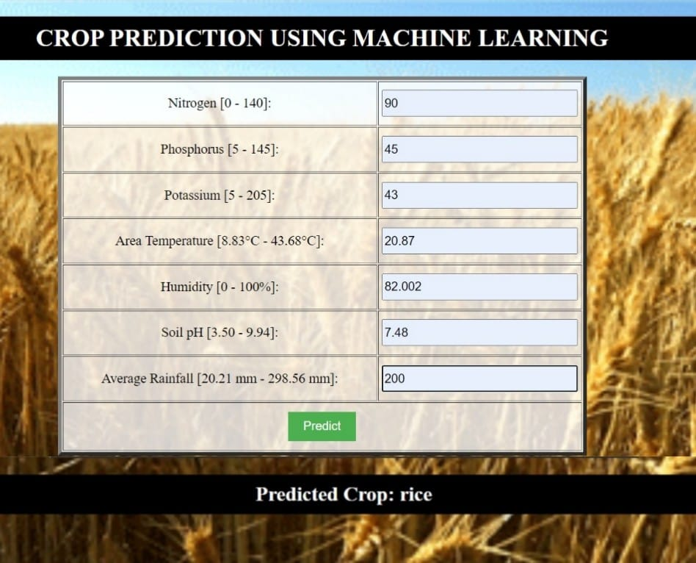
Result:

Slide 10
Future scope
The future scope of the crop prediction project encompasses a wide range of applications, including accuracy improvements, expansion to different crops and regions, early warning systems, and support for sustainable agricultural practices. By leveraging technology, collaboration, and real-time data, the project aims to benefit farmers, policymakers, and the agricultural sector as a whole.

Slide 11
THANK YOU

